Slide 1

HEALTHCARE MANAGEMENT SYSTEM
Sai Gopal Jarabana

Slide 2
INTRODUCTION
Blood is a vital component of healthcare and can save countless lives when donated and used properly. However, blood banks often face various challenges such as shortage of blood, improper inventory management, and lack of communication between donors, staff, and recipients.
To address these challenges, a Blood Bank Management System can be implemented. This system is designed to manage the entire blood donation process from donor registration to blood inventory management and distribution to recipients. The system allows donors to register online, and enables staff to manage donor and recipient information, blood testing and processing, and inventory management.

Slide 3
Software specifications: Front-end: HTML, CSS, for creating the user interface Angular or React for building a web application Bootstrap or Materialize for styling the user interface Back-end: MySQL, Oracle, or Microsoft SQL Server for the database management system PHP, Python, or Node.js for server-side scripting RESTful API for data transfer between the client-side and server-side components Middleware: Apache, Nginx, or IIS for web server configuration Express.js or Flask for building RESTful APIs

Slide 4
USE CASES OF HEALTHCARE MANAGEMENT SYSTEM
Donor:
A donor registers online to donate blood, providing their personal information such as name, contact information, and blood type.
Blood:
A staff member enters the details of the blood bag, including blood type, bag number, expiry date, and quantity, into the system.
A staff member tests and processes the donated blood before adding it to the inventory.
The system sends notifications to staff when the blood is about to expire, prompting them to use or discard it.
Staff:
A staff member logs into the system to manage donor and recipient information, blood inventory, and blood distribution.
Recipient:
A recipient registers online to request a blood transfusion, providing their personal information such as name, contact information, and blood type.
Blood Inventory:
A staff member checks the inventory to see the availability of a particular blood type and quantity.

Slide 5
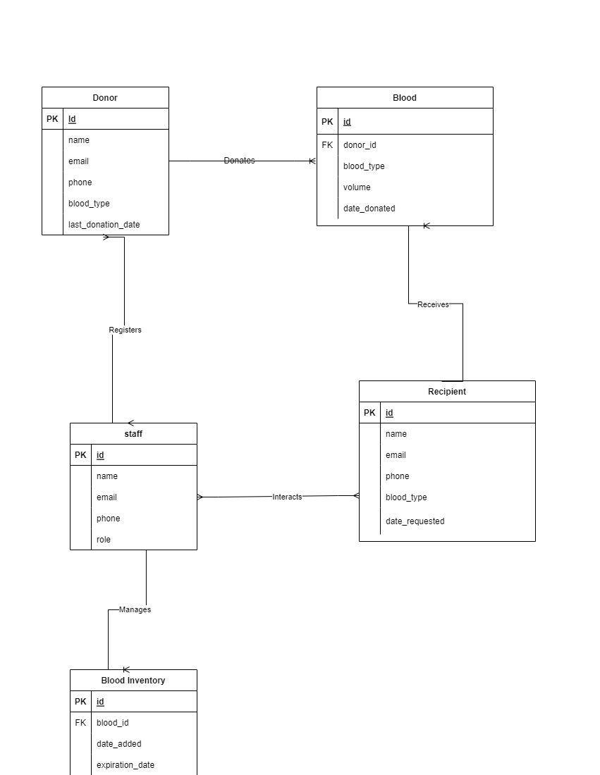
E-R diagram

Slide 6
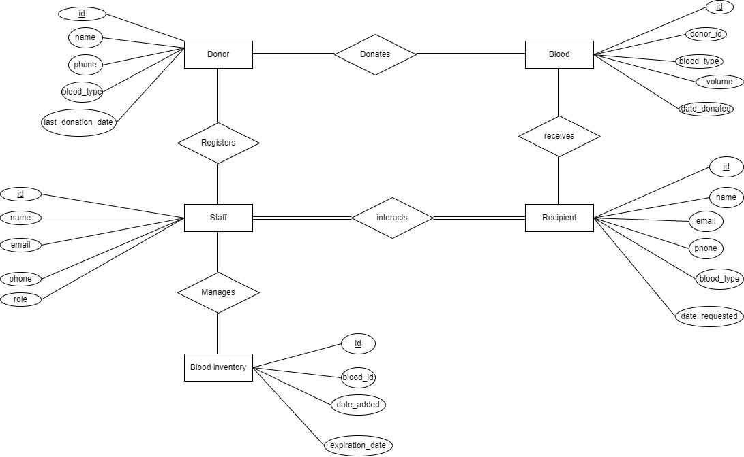
Relational Schema

Slide 7
Entities attributes and relationships
Donor: donor id(PK), Namee, EMAIL, phone no, ,blood_type,last_Donation_date.d
Blood: id (pk), donor id(FK), blood_type, volume, date_donated.
Staff: staff_id(PK), Name, Email, Phone, Role.
Blood Inventory: Bi_Id(pk), Blood_Id(FK), date_added, Expiration date,
Recipient: r_id(pk), Name, email, phone, blood_type, date_requested.

Slide 8
RELATIONSHIPS
1.A Donor can donate many Blood samples, but each Blood sample comes from exactly one Donor.
2.Each Blood sample can be stored in the BloodInventory, and each BloodInventory record corresponds to exactly one Blood sample.
3.A Recipient can receive many Blood transfusions, but each Blood transfusion comes from exactly one Blood sample
4.There may be many Staff members involved in the blood donation and transfusion process, and each Staff member has a unique ID
Overall, these relationships allow the database to track the flow of Blood donations, from the Donor who donates the Blood sample to the BloodInventory where it is stored to the Recipient who receives a transfusion. The Staff table provides information about the people involved in the process.

Slide 9
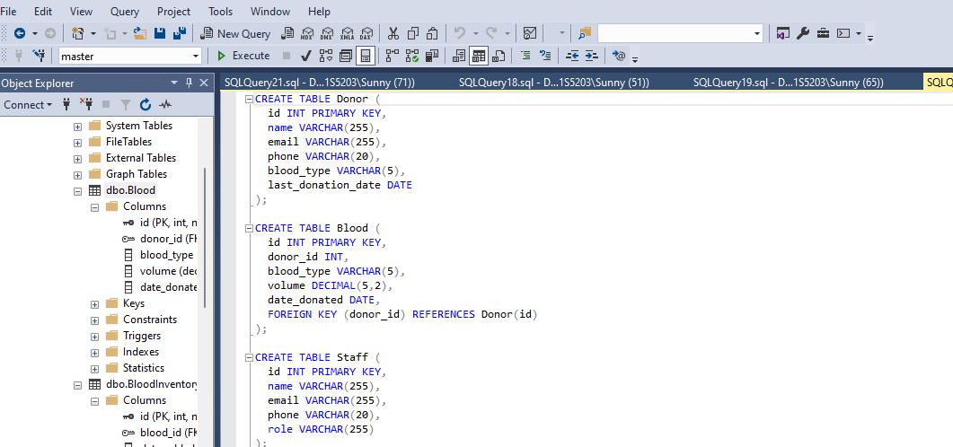
CREATION OF TABLES

Slide 10
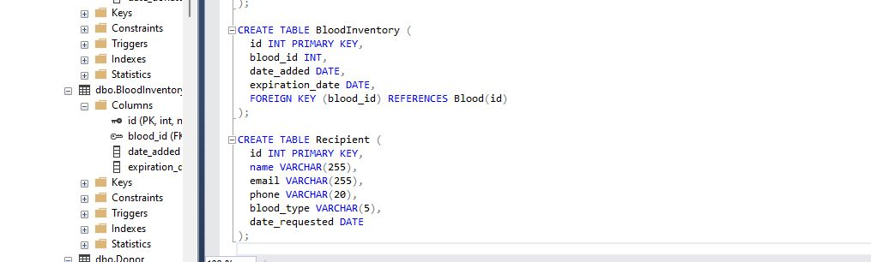

Slide 11
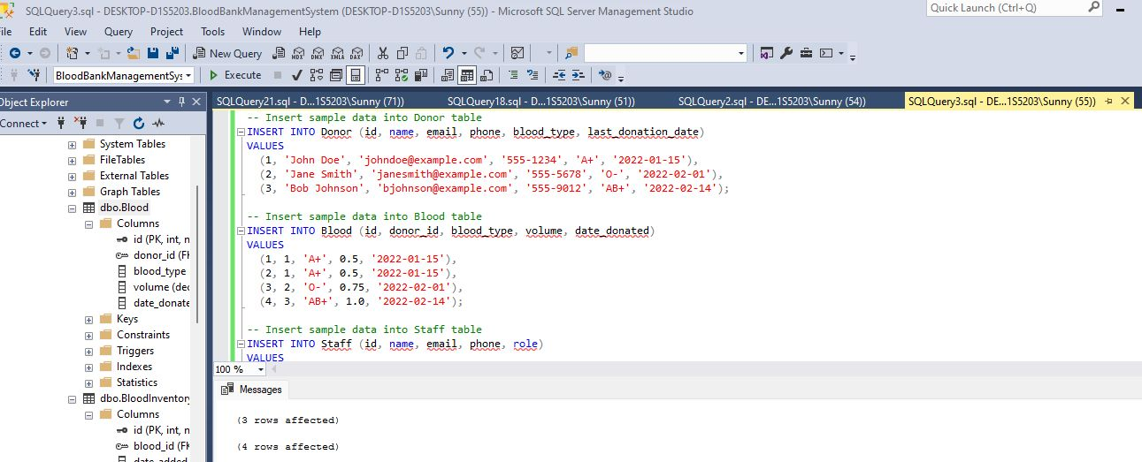
Populating the tables

Slide 12
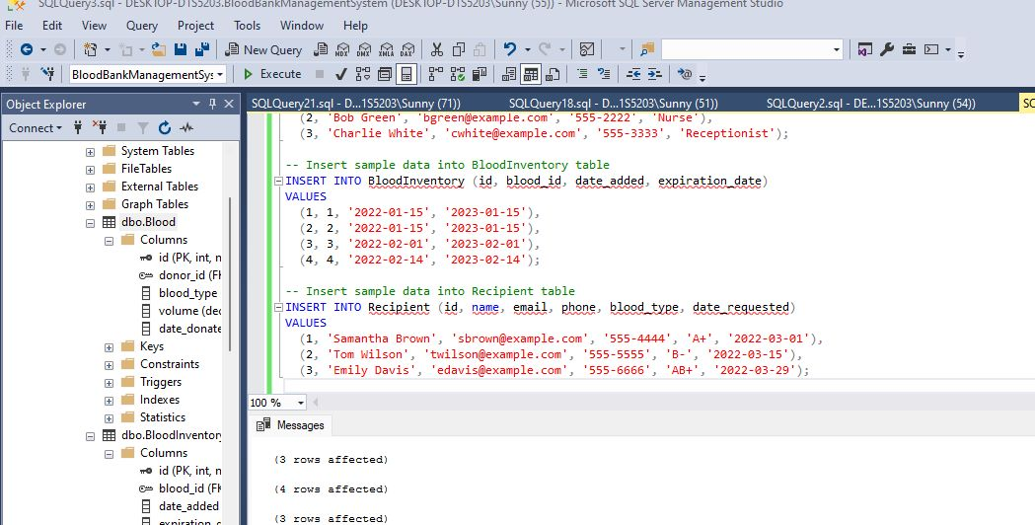

Slide 13
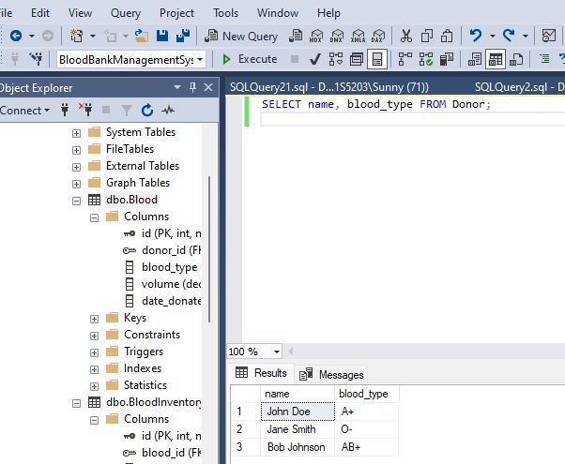
Implementation of queries to retrieve the data

Slide 14
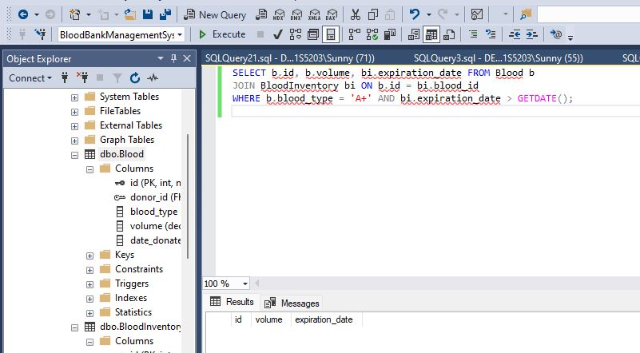
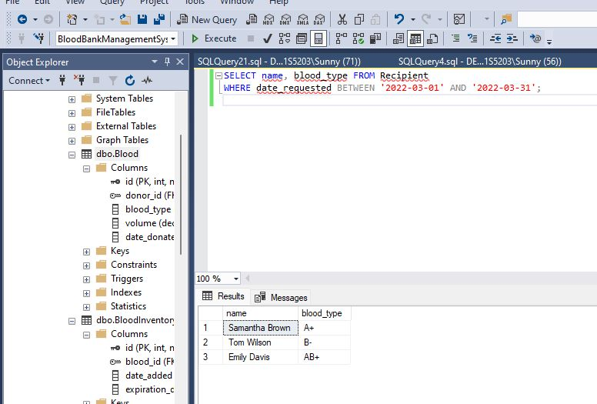

Slide 15
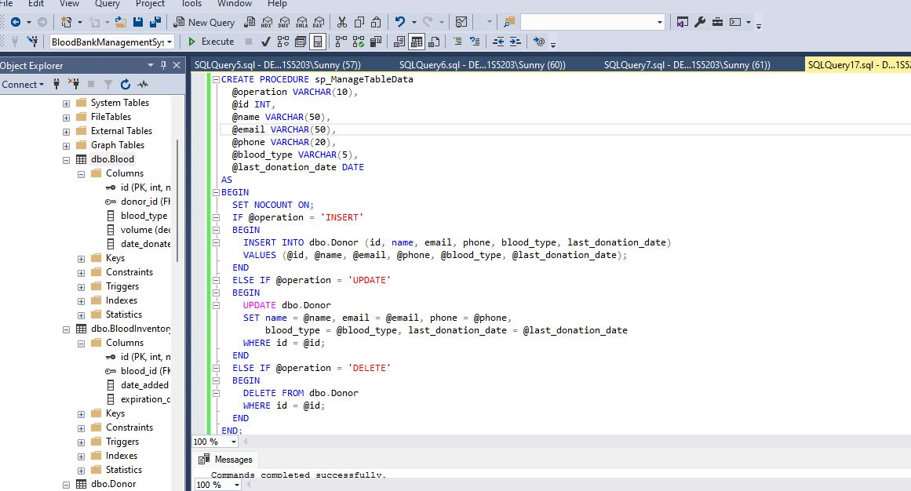
Stored Procedure

Slide 16
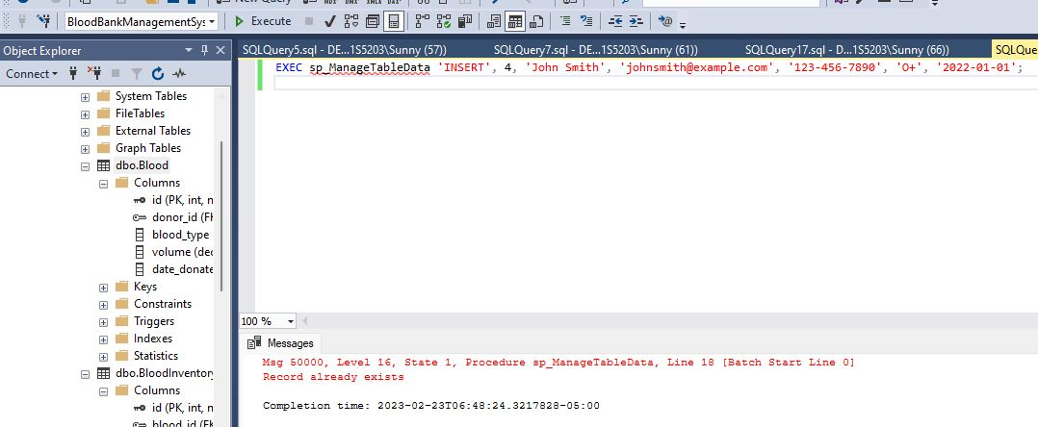
Queries to insert ,update and delete

Slide 17
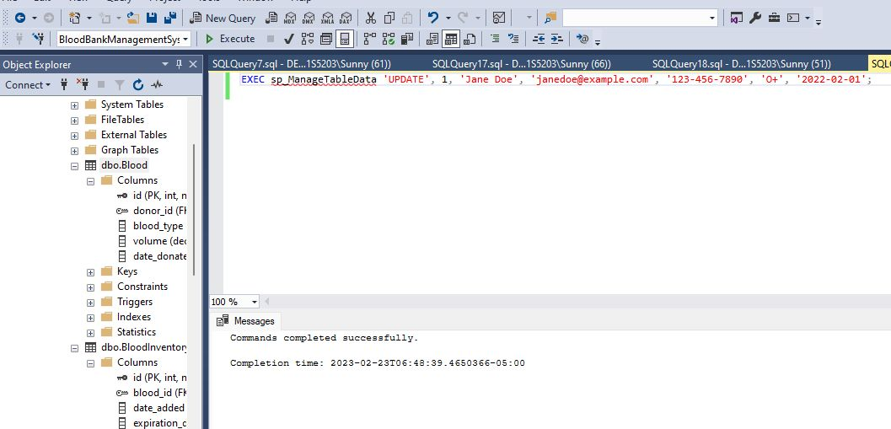
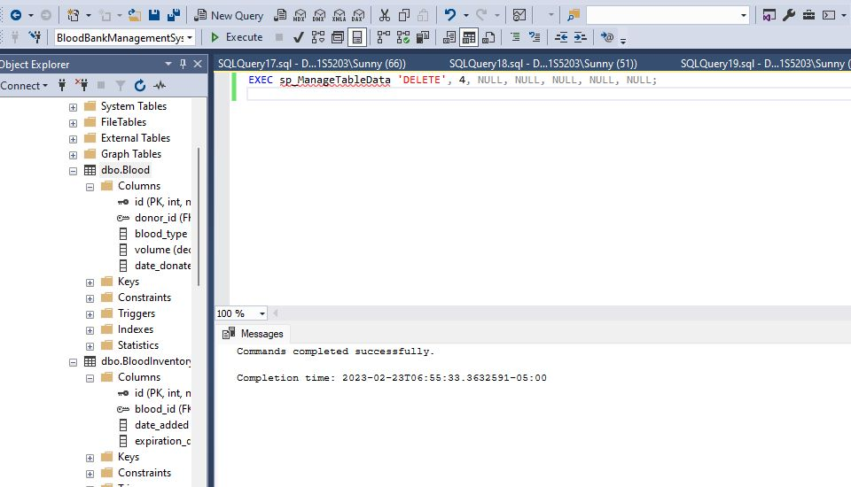

Slide 18

THANKYOU

